Slide 1

Presentation On Fraud News Detection

Slide 2
Agenda
Introduction
Problem statement
Problem understanding
Definition and importance of text classification
Data Analysis and Model Building Flowchart
Exploratory Data Analysis Steps
Data Analysis Steps Done
Model Building
Hyper Parameter Tuning and Crating Final Model
Saving the model and prediction results
Conclusion

Slide 3
Introduction
Fake news on different platforms is spreading widely and is a matter of serious concern, as it causes social wars and permanent breakage of the bonds established among people. A lot of research is already going on focused on the classification of fake news. classification of fake news.
The rampant spread of fake news on social media has skyrocketed over the years. Fake news has become a notorious devil affecting the overall demographic of the nation. Its not only regular users who are worried but also the marketers who raised concerns about the impact of fake news on trade.

Slide 4
Problem Statements
Fake news has become one of the biggest problems of our age. It has a serious impact on our online as well as offline discourse. One can even go as far as saying that, to date, fake news poses a clear and present danger to western democracy and stability of the society.
Fake News contains misleading information that could be checked. This maintains lies about a certain statistic in a country or exaggerated cost of certain services for a country, which may arise unrest in some countries like in Arabic spring. There are organizations, like the House of Commons and the Crosscheck project, trying to deal with issues by confirming authors are accountable.
However, their scope is so limited because they depend on human manual detection, in a globe with millions of articles either removed or being published every minute, this cannot be accountable or feasible manually.

Slide 5
Problem Understanding
Fraud can have a devastating impact on a business. In 2001, a massive corporate fraud was uncovered at Enron, a U.S.-based energy company. Executives used a variety of techniques to disguise the company’s financial health, including the deliberate obfuscation of revenue and misrepresentation of earnings.
After the fraud was uncovered, shareholders saw share prices plummet from around $90 to less than $1 in a little over a year. Company employees had their equity wiped out and lost their jobs after Enron declared bankruptcy.

Slide 6
Importance of Fraud News Detection
Implementing fraud news filtering is extremely important for any organization. Not only does spam filtering help keep garbage out of the news, but it also helps with the quality of life of business emails because they run smoothly and are only used for their desired purpose. Fraud news filtering is essentially an anti-malware tool, as many attacks through news are trying to trick users to click on a malicious attachment, asking them to supply their credentials, and much more.
Nowadays, every site and application uses a machine-learning approach. Machine Learning has simplified the task that may take a long duration to complete without it. Most of the approaches require text analysis and classification techniques. Classification of the comments is necessary before posting on online platforms. This classification model helps to prevent online abuse and cyberbullying.

Slide 7
Data Analysis and Model Building Flowchart
Import Libraries
Import Dataset
Feature Engineering
Checking Correlation
NLTK Text Pre-Processing
Visualizations
(EDA)
TF-IDF Vectorizer
Data Balancing
Model Building
Saving the model and Predictions
AUC-ROC Curve
Hyper Parameter Tuning

Slide 8
Exploratory Data Analysis Steps
Importing necessary libraries and importing datasets as a data frame.
Checked some statistical information like shape, several unique values present, info, finding zero values, etc.
Checked for null values and find null and no null values. But, find white spaces so we removed them.
Done feature engineering and created new columns viz label: which contain both spams and not spam texts.
Visualized each feature using seaborn and matplotlib libraries by plotting count plots like pie plots, count plots, and word clouds for each label.
Done text pre-processing techniques like Removing Punctuations and other special characters, Splitting the comments into individual words, Removing Stop Words, Stemming, and Lemmatization. Then created a new column as text_nlp after cleaning the data. All these steps were done on both train and test datasets. Checked correlation using heatmap. After getting cleaned data used the TF-IDF vectorizer.

Slide 9
Data Analysis Steps Done
I have extracted some features and removed the feature where null values are present a lot of for to improve data normality and linearity.
Done text pre-processing techniques like
Removing Punctuations and other special characters,
Splitting the comments into individual words,
Removing Stop Words,
Stemming and Lemmatization.
Then created a new column as text nlp after cleaning the data. All these steps were done on both train and test datasets.
After getting cleaned data used the TF-IDF vectorizer. It’ll help to transform the text data into a feature vector that can be used as input modeling. It is a common algorithm to transform the text into numbers. It measures the originality of a word by comparing the frequency of appearance of a word in a document with the number of documents the words appear in.
Split train and test to build machine learning models. The model-building process will be shown in further steps.

Slide 10
Model Building
In this project 6 features define the type of text feature named “label” which is combined all the above features and contains the labeled data into the format of 0 and 1 where 0 represents “NO” and 1 represents “Yes”. In this NLP-based project, we need to predict binary text. I have converted text into feature vectors using TF-IDF vectorizer and separated our features and labels. Also, before building the model, I made sure that the input data is cleaned and scaled before it was fed into the machine-learning models.
After the pre-processing and data cleaning I used the remaining independent features for model building and prediction. The classification algorithms used in training the data are as follows:
Logistic Regression
MultinomialNB
GaussianNB
BernoulliNB
Decision tree Classifier
Kneighbors Classifier
Ada boost Classifier
Gradient Boosting Classifier
Random Forest Classifier

Slide 11
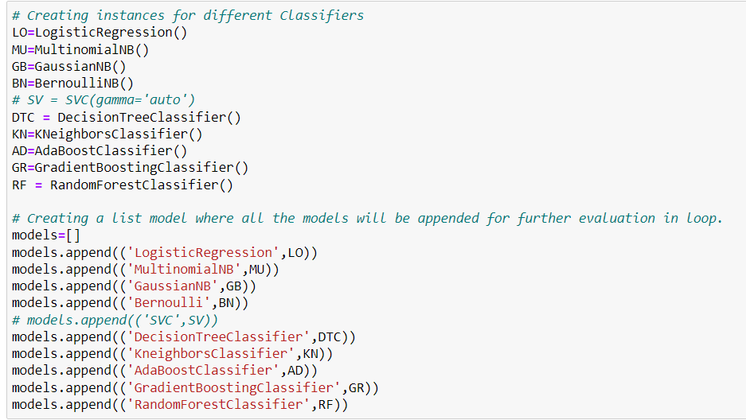
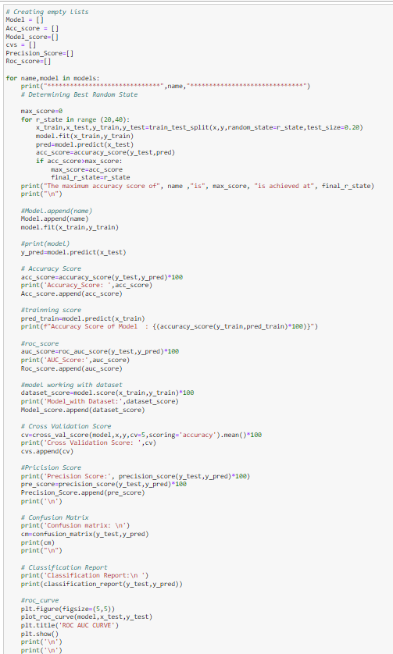
First, create instances for different classifiers and then listed down the models that will be appended for further evaluation in for loop

Slide 12
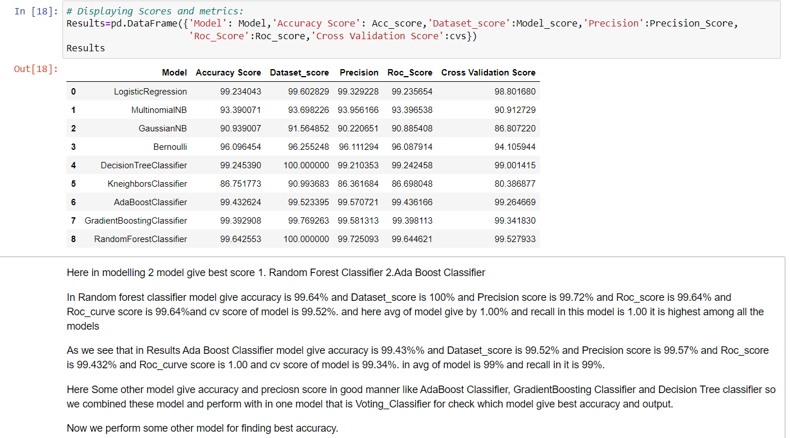

Slide 13
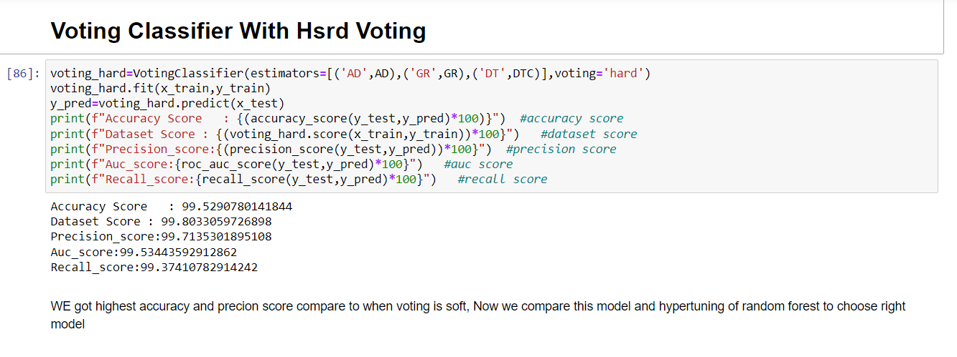
Hyper Parameter Of Random Forest Classifier

Slide 14
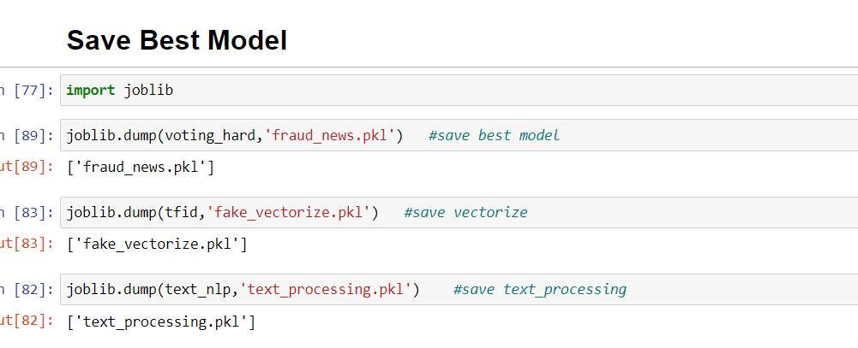
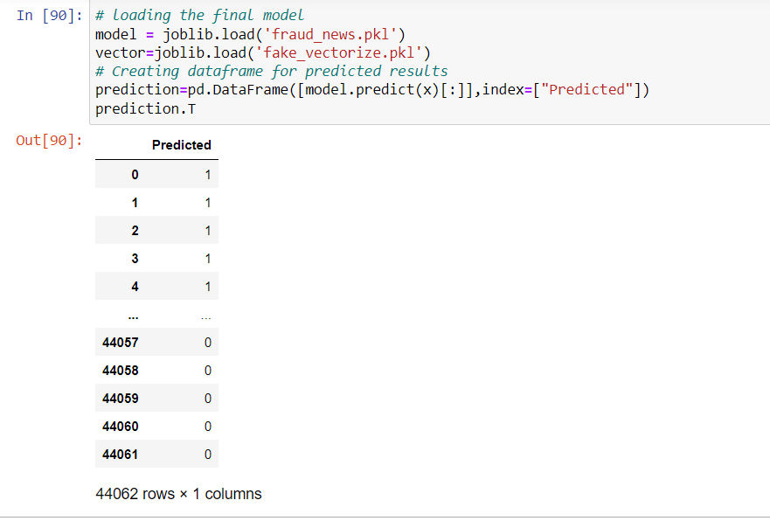
I have saved my final best model by joblib library in pkl format and loaded the saved model for prediction

Slide 15
Conclusion
This case study gives an idea of NLP text processing in machine learning. In this case study, apart from applying the techniques that we have learned in the EDA module, we also classified true and false news so that they can be controlled and restricted from fraudulent news.
From this dataset we were able to understand the idea of Natural Language Processing using machine learning models. This model helps us to understand whether the news is fraudulent or true.
We have mentioned step by step procedure to analyze the data and checked the correlation between label and feature.
In this project there are some variables like spam and ham which are highly correlated it is possible because one c text may have a combination of multiple features.
• Removing the null values does not impact the model training.
• Using a Tree, the model can reduce the false negative values
• It has future scope in various use cases likewise in elections, social media, etc, where every day there are multi offensive comments spread.
Data cleaning is one of the most important steps to remove unrealistic values and unnecessary stop words.
We got the Voting Classifier as the best model and performed hyperparameter tuning using the best parameters of the RFC model and precision score and the model accuracy and roc-auc score increased after tuning.
After that we saved the model in a pickle with a filename to use it whenever we require. Then we loaded the saved file and predicted the values for test data. Further, we saved the predicted values test data into csv file.

Slide 16
THANKS

